Slide 1
Social Media & addiction
Erwan KAAWAR
Dorian MAURY

Slide 2

Part 1 : Social Media

Slide 3
What is a social media ?
A Social Media is a form of communication on the Internet through which users share information, ideas, personal messages and other content

Slide 4



Different type of Social Media
Business Oriented All about discovery Sharing content

Slide 5
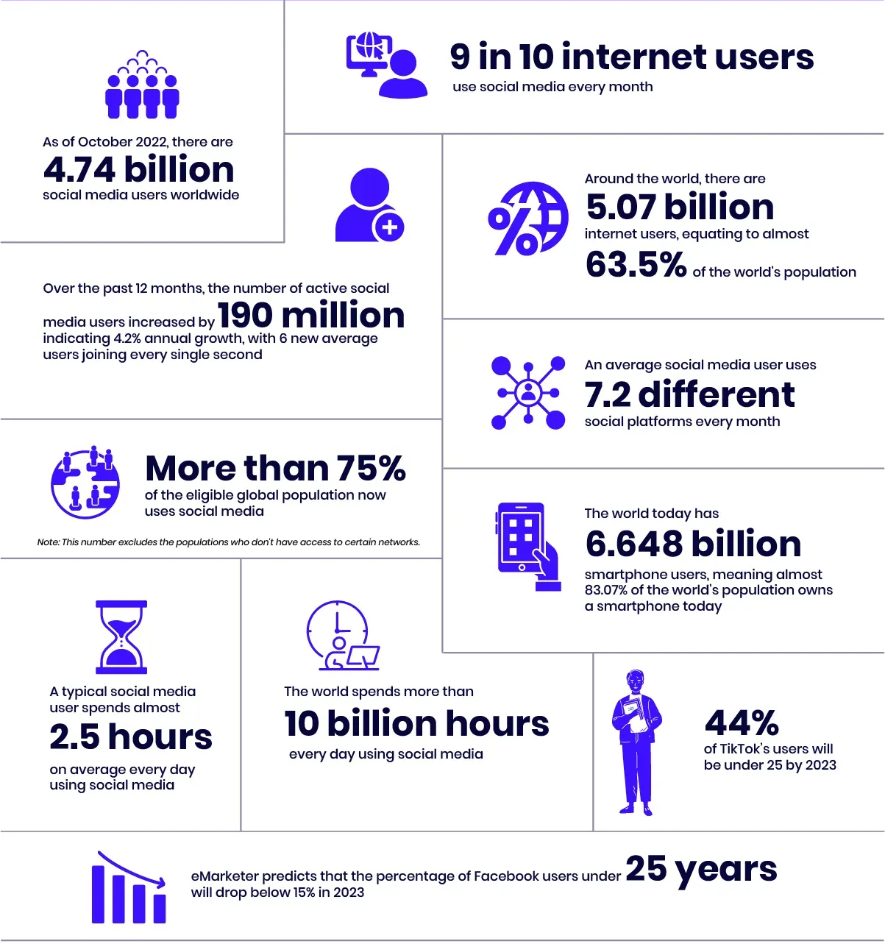
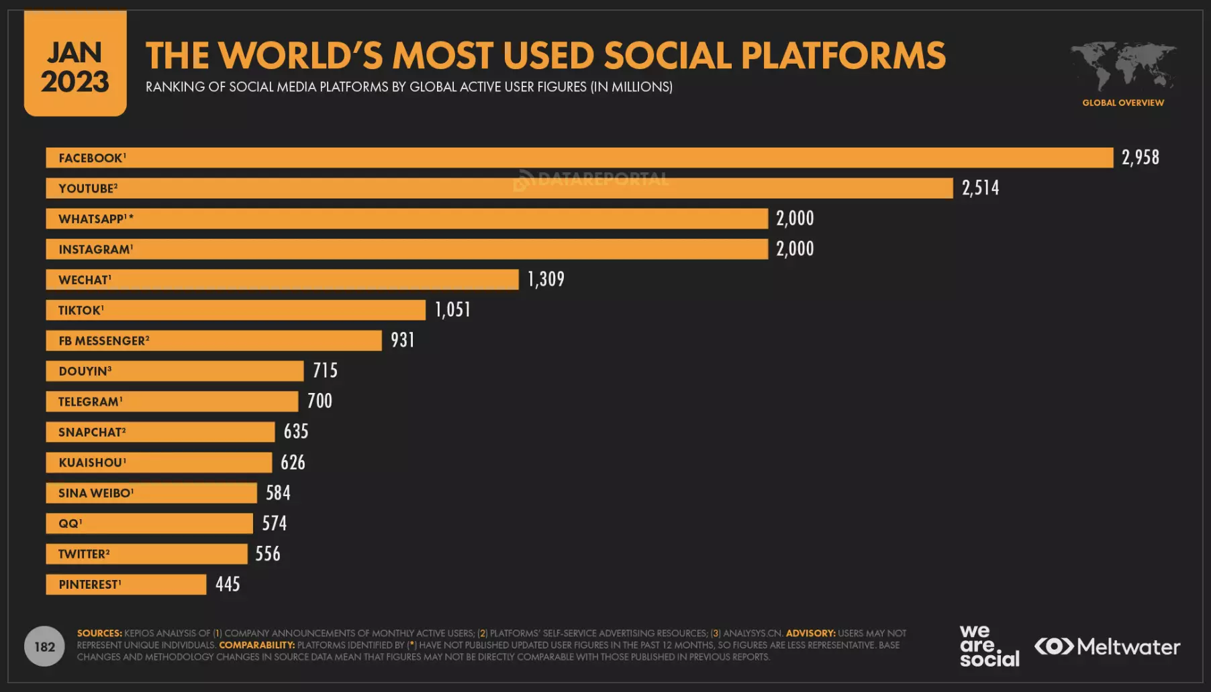
(LinkedIn doesn’t share their stats about active users)
General Statistics about Social Media

Slide 6

Part 2 : Addiction → the reasons and effects

Slide 7
what is addiction?
Addiction : the fact or condition of being addicted to a particular substance or activity.

Slide 8

why people are addicted to social media
→ FOMO (Fear of Missing Out) syndrome
→ Followers, likes, shares
→ easy access
→ algorithms
DOPAMINE: a chemical that gives us a good feeling

Slide 9
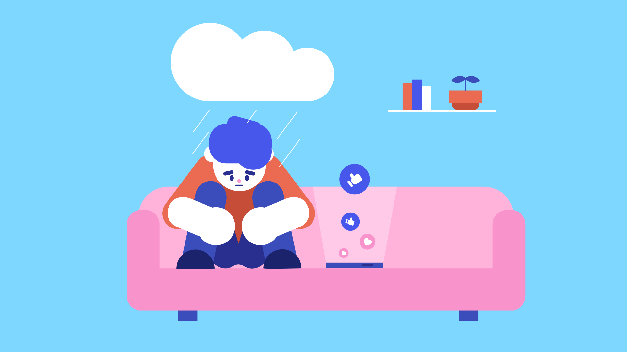
Bad effects
→ time-consuming
→ Social isolation
→ sleep disorders
→ loss of privacy

Slide 10
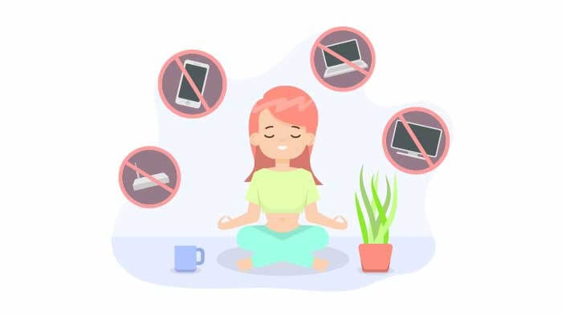
Solutions
→ Limit your time online (Parental control)
→ Protect children (age limit)
→ Sports
→ going out with friends

Slide 11

Conclusion

